Slide 1
Presentation
FULL REPORT
Introduction where you discuss the business problem and who would be interested in this project.
Business Problem : To find which place is best to start new Indian Restaurant in the areas given below:
102 North End Ave in Newyork
(or)
Murray Street in Newyork
Useful for any person who wants or planning to start a new Indian business in and around Newyork “102 North End Ave in Newyork” or “Murray Street in Newyork”

Slide 2
Data where you describe the data that will be used to solve the problem and the source of the data.
Data source :
We need to extract location data of newyork city from foursquare api 'https://api.foursquare.com/with our client id, client secret, and other required search keys.
Data Requirements:
1) Areas Locations 2) Latitudes and Longitutdes 3) Names of Restaurants

Slide 3
Methodology section which represents the main component of the report where you discuss and describe any exploratory data analysis that you did, any inferential statistical testing that you performed, and what machine learnings were used and why.
Step-1) Imported required libraries
Step-2) Define Foursquare Credentials and Version
Step-3) Getting Lat Longs of '102 North End Ave, New York, NY' where we desire to search for existing indian hotels
Step-4) Search for a specific venue indian category
Step-5) Define the corresponding URL & Send the GET Request and examine the results
Step-6) Get relevant part of JSON and transform it into a pandas dataframe
Step-7) Define information of interest and filter dataframe
Step-8) Exploratory Analysis by visualize the Indian restaurants that are nearby

Slide 4
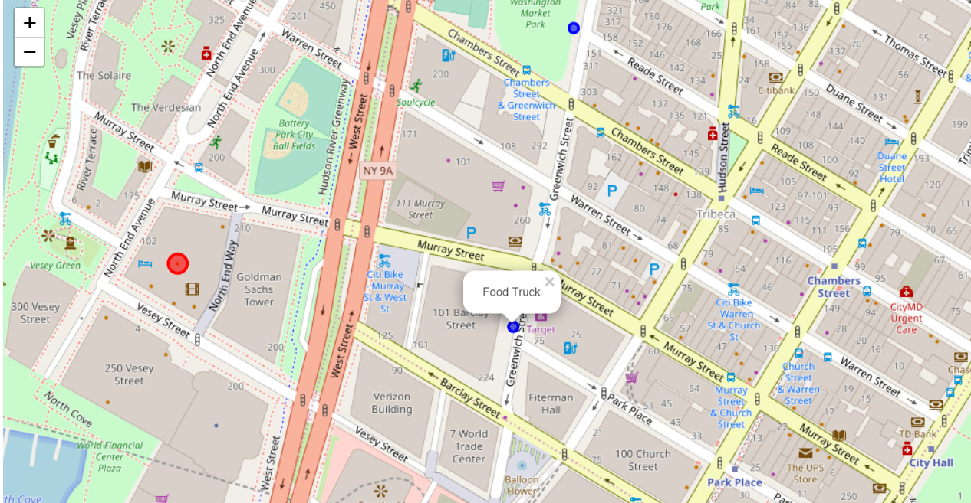

Slide 5
Results section where you discuss the results.
Analysis from the visualized map shows that there is already one Indian restaurant at Murray Street and No Indian Restaurants at "102 North End Ave in Newyork"
Results & Solution : So, its a Wise Decision to start a New Indian Restaurant near "102 North End Ave in Newyork" rather than at Murray Street in NewYork.

Slide 6
Discussion section where you discuss any observations you noted and any recommendations you can make based on the results.
If we start Indian business at Murray street which is already having one Indian restaurant then there might not be much customer visits and business development due to already competition from existing restaurant.
So,From the Analysis and results it is recommended to start a new Indian restaurant near “102 North avenue”.

Slide 7
Conclusion section where you conclude the report.
Due to above facts and Data Analysis came to Conclusion that starting new Indian restaurant in the “102 North Avenue is a good place of choice”

